Slide 1
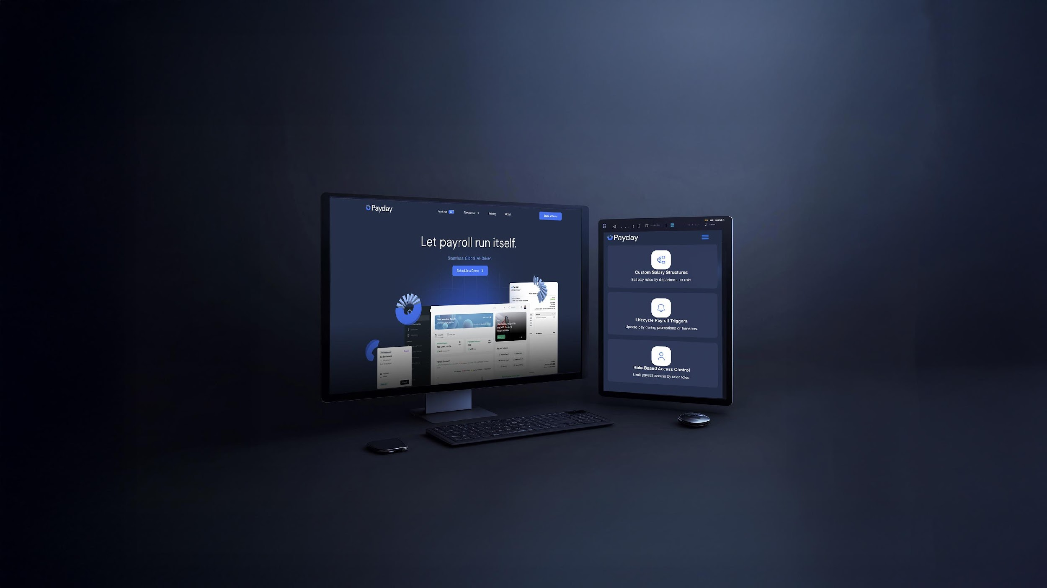
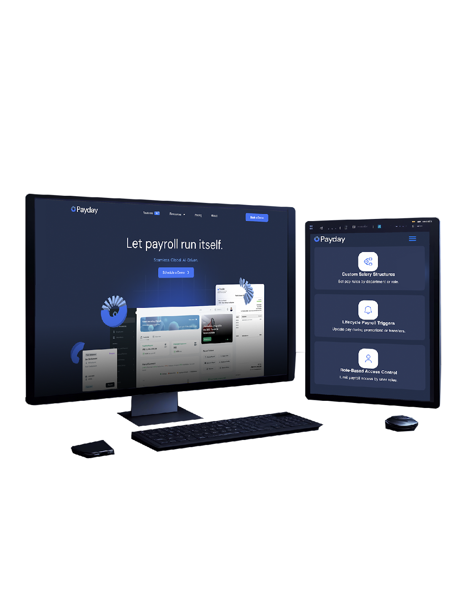

Powering Payroll Simplicity with AI

Slide 2


Payroll Is Broken. We Fixed It.
One Platform. End-to-End Payroll & HR.
PayDay Suite offers a
comprehensive payroll
+
HR automation platform
ideal for enterprises running global payroll:
02

Slide 3


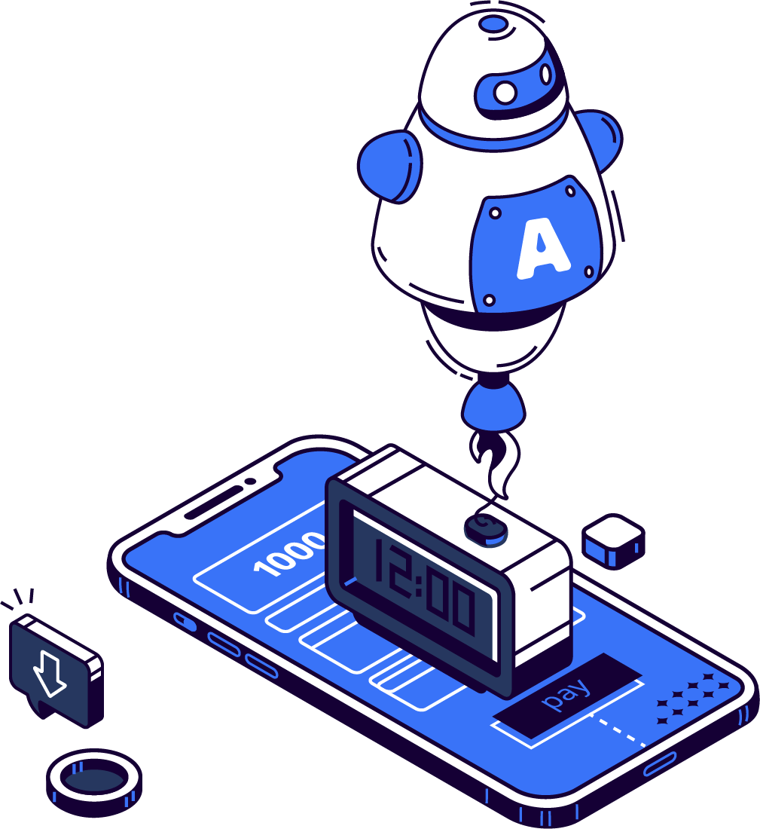





One Platform.
End-to-End Payroll & HR.
HR Lifecycle Tools
One-Click Payroll
Multi-Language Support
AI Fraud Detection
Bank & ERP Integrations
Multi-Country Compliance
03

Slide 4



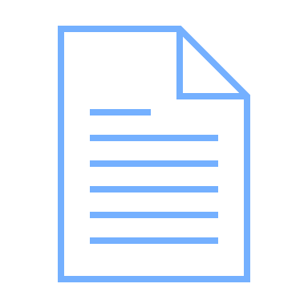



Employee Onboarding
Approval & Execution
Payslips + Compliance Reports
Attendance Integration
AI-Powered Salary Calculation
From Hire to Paycheck All In One Flow
Final Settlements
04

Slide 5

Trusted by Leading Companies Across the GCC
Built by people who’ve done Payroll the Hard way
1000+ Companies Started
5+ Countries
50K+ Users Monthly
05

